Slide 1






Advanced Data Structure and Algorithms
Trees
Graphs
Hashing
Search trees, Indexing, and multiway trees
File Organization

Slide 2

UNIT 5 File organization
Image courtesy: cbgraphics.net
References:
Online references for Python
Data structures by Dr. Varsha Patil

Slide 3





Contents
Sequential file organization
Concept and primitive operations
Direct Access File
Indexed sequential file organization
- Types of indices
- Structure
Linked Organization
- Multi-list files
- Coral ring, inverted files and cellular partitions
External Sort
- Merging two lists
- Multiday merging- a k-way merge algorithm

Slide 4

Files

Slide 5

Why to use Files ?
Convenient way to deal large quantities of data.
Stores data permanently (until file is deleted).
File storage can avoid re-generation of data.
Data can be shared between programs.
Can perform various operations on file.
Programming efforts?
How to "connect" file to program
How to tell the program to read data
How to tell the program to write data
Error checking and handling EOF

Slide 6
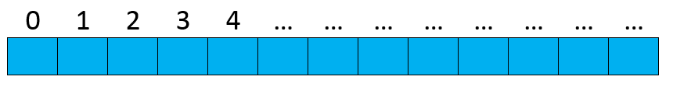
A file
At the fundamental level, a file is a sequence of bytes numbered from 0 upwards

Slide 7

Files
Create File/ Append
Open File
Operations on File
Close File
Files are written on Disks
Disk read/write is much slower than memory
Disk data is read/written in large blocks
Buffer- temporary parking place for data
Main Memory
Buffer
Objects (of various types)
Files
(sequences of bytes)
Connect to a buffer (Open a file)
Create file handle to file on disk to get access to a buffer from which data can be read or written.
Disconnect the handle (Close a file)

Slide 8
File Operations
To read a file
We must know its name
We must open it (for reading)
Then we can read
Then we must close it
That is typically done implicitly
To write a file
We must name it
We must open it (for writing)
Or create a new file of that name
Then we can write it
We must close it
That is typically done implicitly

Slide 9
Header file in C++
Streams act as an interface between files and programs.
They represent as a sequence of bytes and deals with the flow of data.
Every stream is associated with a class having member functions and operations for a particular kind of data flow.
File 🡪 Program ( Input stream) - reads
Program 🡪 File (Output stream) – write
All designed into fstream.h and hence needs to be included in all file handling programs.

Slide 10
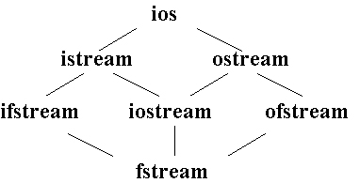
Classes for Stream I/O in C++
When working with files in C++, the following classes can be used:
ofstream – writing to a file
ifstream – reading for a file
fstream – reading / writing
When ever we include <iostream.h>, an ostream object, is automatically defined – this object is cout.
ofstream inherits from the class ostream (standard output class).
ostream overloaded the operator << for standard output.…thus an ofstream object can use methods and operators defined in ostream.
ios is the base class.
istream and ostream inherit from ios
ifstream inherits from istream (and ios)
ofstream inherits from ostream (and ios)
iostream inherits from istream and ostream (& ios)
fstream inherits from ifstream, iostream, and ofstream

Slide 11
File i/o Streams
Stream Classes required for File i/o :
ifstream
ofstream
fstream

Slide 12
File Modes in C++
Name | Description
ios::in | Open file to read
ios::out | Open file to write
ios::app | All the date you write, is put at the end of the file. It calls ios::out
ios::ate | All the date you write, is put at the end of the file. It does not call ios::out
ios::trunc | Deletes all previous content in the file. (empties the file)
ios::nocreate | If the file does not exist, opening it with the open() function gets impossible.
ios::noreplace | If the file exists, trying to open it with the open() function, returns an error.
ios::binary | Opens the file in binary mode.

Slide 13
Open File in C++
#include <fstream>
int main(void)
{
ofstream outFile("file1.txt", ios::out);
outFile << "That's new!\n";
outFile.close();
Return 0;
}
If you want to set more than one open mode, just use the OR operator- |. This way:
ios::in | ios::out

Slide 14
File pointers
Functions for manipulation of file pointers seekg() Moves get pointer (input) to a specified location.
seekp() Moves put pointer (output) to a specified location.
tellg() Gives the current position of the get pointer.
tellp() Gives the current position of the put pointer.
Seekg(offset ,reference-position)
Offset- any constant specifying location. The parameter offset represents the number of bytes the file pointer to be moved from the location specified by the parameter refposition.
Reference-position is
ios::beg
ios:: end
ios:: cur

Slide 15
Binary files
Functions for binary file handling
get(): read a byte and point to the next byte to read
getline(line,size): read a line with size cha.
put(): write a byte and point to the next location for write
read(): block reading
write(): block writing
flush():Save data from the buffer to the output file.

Slide 16
Binary File I/O Examples
//Example 1: Using get() and put()
#include <iostream>
#include <fstream>
void main()
{
fstream File("test_file",ios::out | ios::in | ios::binary);
char ch;
ch='o';
File.put(ch); //put the content of ch to the file
File.get(ch); //read one character
cout << ch << endl; //display it
File.close();
}

Slide 17
File I/O Example: Writing
#include <fstream>
using namespace std;
int main(void)
{
ofstream outFile(“fout.txt");
outFile << "Hello World!";
outFile.close();
return 0;
}

Slide 18
File I/O Example: Reading
#include <iostream>
#include <fstream>
int main(void)
{
ifstream openFile(“data.txt"); //open a text file data.txt
char ch;
while(!OpenFile.eof())
{
OpenFile.get(ch);
cout << ch;
}
OpenFile.close();
return 0;
}

Slide 19
outFile.write((char*)&obj, sizeof(obj));
&obj - this is the memory address of the object called obj.
(char*) &obj - you are type casting &obj into a character pointer.
sizeof(obj) - yields the size of the object that you are referring to.
fin.read - this is the function call evoked by the fin object.

Slide 20

FILE ORGANIZATION
Refers to the way data is stored in a file.
Important as it determines the methods of access, efficiency, flexibility and storage devices to use.

Slide 21

TYPES OF FILE ORGANIZATION
Sequential
Indexed Sequential
Direct Access /Random Access

Slide 22
Sequential File Organization (Simplest kind of data organization)

Slide 23
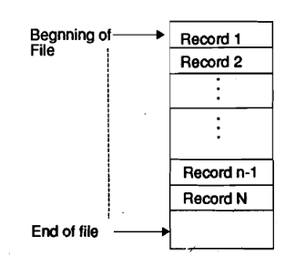
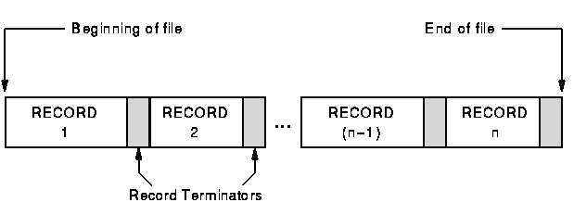
Sequential file

Slide 24
Advantages
Simple file design
Very efficient when most of the records must be processed e.g. Payroll
Very efficient if the data has a natural order
Can be stored on inexpensive devices like magnetic tape.

Slide 25
Disadvantages
Entire file must be processed even if a single record is to be searched.
Transactions have to be sorted before processing
Overall processing is slow – time consuming process

Slide 26
Direct (Random) File Organization
Records are read directly from or written on to the file.
The records are stored randomly throughout the file at known address.
The records does not need to be in sequence because they are updated directly and rewritten back in the same location.
Address is calculated by applying a mathematical Hashing function to the key field; hence named as direct access file organization.
This file organization is useful for immediate access to large amount of information. It is used in accessing large databases.
Notes:
With direct access file, the address for record
storage and retrieval is computed by using a ‘hashing’ algorithm. As we retrieve the record
directly with the help of the key and the hash function, without considering the position of
the record in the file, the organization is known as direct access file organization.

Slide 27
Direct (Random) File Organization
Records
Keys
B U C K E T S
Hash Function
Memory
A random file would have to be stored on a direct access backing storage medium e.g. magnetic disc, CD, DVD
Search records using key; (the address of the record to retrieve it directly)
Example : Any information retrieval system. E.g. Train timetable system.
Notes:
With direct access file, the address for record
storage and retrieval is computed by using a ‘hashing’ algorithm. As we retrieve the record
directly with the help of the key and the hash function, without considering the position of
the record in the file, the organization is known as direct access file organization.

Slide 28
Advantages
Any record can be directly accessed.
Quick retrieval of records; accesses the desired records immediately.
Records can be of different sizes.
Speed of record processing is very fast.
Up-to-date file because of online updating.
Concurrent processing is possible.
Notes:
Concurrent processing is sometimes said to be synonymous with parallel processing.

Slide 29
Disadvantages
MORE COMPLEX THAN SEQUENTIAL
DOES NOT FULLY USE MEMORY LOCATIONS
MORE SECURITY AND BACKUP PROBLEMS

Slide 30
Indexed sequential file
An indexed sequential file is a sequential file (i.e. sorted into order of a key field) which has an index.
Data file – Actual data
Records are stored sequentially.
Each record of a file has a key field which uniquely identifies that record.
Index file – Pointer to data
Index file is prepared for accessing the record directly.
An index file is an ordered file whose records are of fixed length with two fields - keys and addresses.
The first field is of the same data types as the ordering key field of the data file, and the second field is a pointer to a disk block - a block address.
Second field can be an address of another file or disk block.

Slide 31
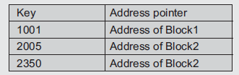
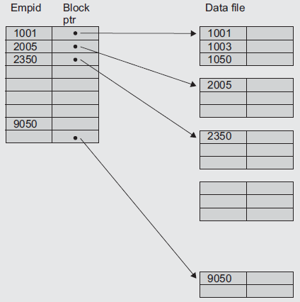
Data file contains the actual employee records as per their employee ids.
Empid is the key field
Index file contains 2 fields:
1st field – Empid (key field)
2nd field – Block pointer(offset of the block)
i.e. Employee id’s from 1001 to 2004 are stored in Block 1
Employee id’s from 2005 to 2349 are stored in Block 2 and so on
Index file
Indexed sequential files are important for applications where data needs to be accessed sequentially and randomly using the index.
Notes:
Consider that an employee file is stored as an indexed sequential file. The entries are as shown in Fig

Slide 32
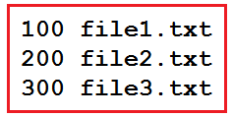
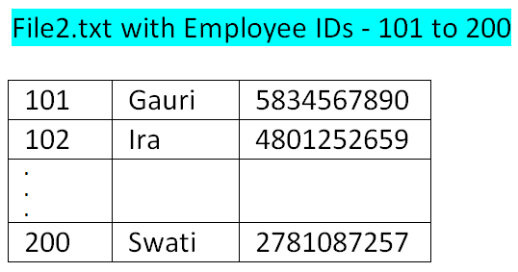
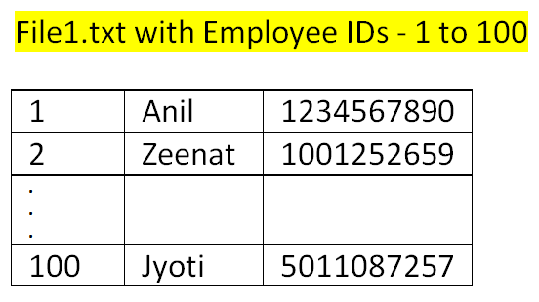
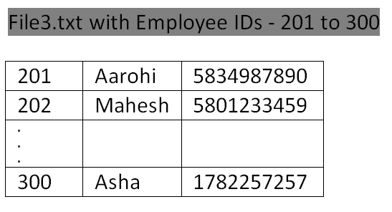
Practical assignment approach
Index file
Second field i.e. file1.txt, file2.txt and file3.txt are considered as the block pointers
Data files – file1.txt; file2.txt; file3.txt (Employee Record-EmpID, Name and Phone number)

Slide 33
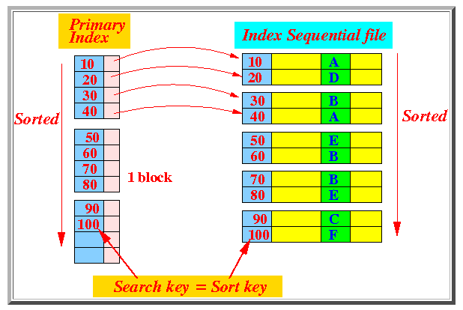
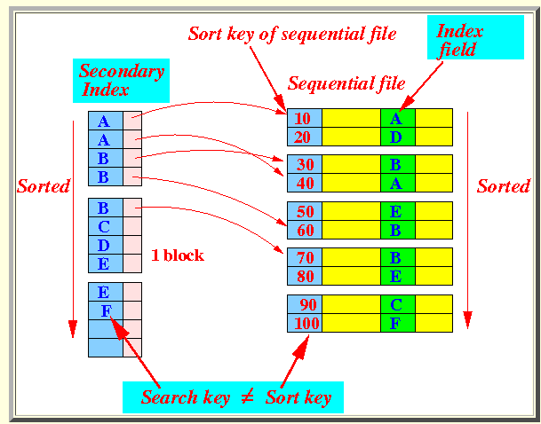
Types of indices
Primary index
It is an index ordered in the same way as the data file, which is sequentially ordered according to a key. The indexing field is equal to this key.
Secondary index
This is an index that is defined on a non-ordering field of the data file. The indexing field need not contain unique values.
Clustering index
A data file can associate with utmost one primary index and several secondary indices. Key searches are improved.

Slide 34
Advantages
In indexed sequential access file, sequential file and random file access is possible.
It accesses the records very fast if the index table is properly organized.
The records can be inserted in the mid of the file.
It provides quick access for sequential and direct processing.
It reduces the degree of the sequential search.

Slide 35
Disadvantages
Requires unique keys and periodic reorganization.
Takes longer time to search the index for the data access or retrieval.
Extra storage space for the index is required

Slide 36
File Handling Programs
For Pseudocode/Algorithm of
Sequential File
Random Access File
Simple Index File
Refer Laboratory Programs

Slide 37
LINKED ORGANIZATION
In linked organization, the logical sequence of records is different from the physical sequence of records.
In sequential, i^{th} record is placed at location L_{i}, then the i+1th record is placed at L_{i} + c where c is the length of i^{th} record or some fixed constant.
In linked organization the next logical record is obtained by following link value from present record.
Say an employee record takes 50 bytes;
Sequential organization:
Linked Organization:
Offset/ Loc | ID | Name | Phone# | Dept
0 | E1
50 | E2
100 | E3
150 | E4
E₁ |  |  |  |  |  | E₂ |  |  |  |  |  | ….. | E_{n}
Records are linked according to increasing primary key, so insertion and deletion is easy.
Searching for a particular record is difficult since no index is available, so only sequential search possible.

Slide 38

Types of linked organization
Multilist Files
Coral rings
Inverted Files
Cellular Partitions

Slide 39

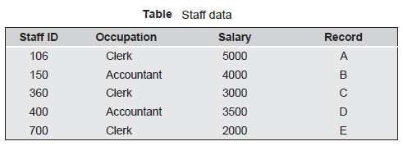
Multilist Files
Facilitates the search process - several indexes are maintained as per primary key and secondary keys, one index per key.
The record may be present in different lists as per key.
Possibilities of indexing:
Indexes corresponding to ranges of Staff ID eg. 101-300, 301-600, 601-900, and so on
All records with same range can be linked together in a list.
This idea can be generalized for secondary key level also.
Notes:
With linked organization; Search for a particular record is difficult as no indices are available - only sequential search possible.

Slide 40
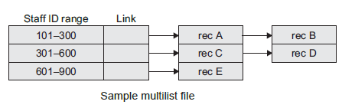
All the records with staff ID in the same are linked together.
Each record has values of all the fields + link to the next record in the group.
The multilist structure for file representation can also be maintained with indices on different keys and allow records to be in more than one list.
Notes:
With linked organization; Search for a particular record is difficult as no indices are available - only sequential search possible.

Slide 41
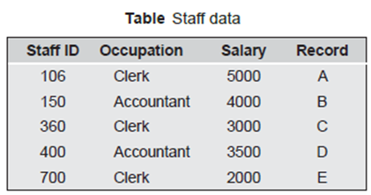
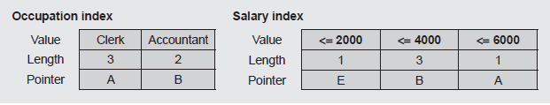
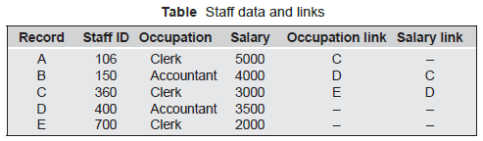
Multilist struct with indices on different keys
Notes:
When multilists are maintained, then length of the link is also maintained in the index.
When two lists are searched simultaneously, then the search time can be reduced by searching the smaller list.

Slide 42

Coral Rings
Coral rings = Multilist + Doubly linked list structure
Links are used to link all records with same key value.
Back pointers are ease the process of search, addition, updation, and deletion without going to start pointer every time.
Some records traverse with the help of back pointer and for others it is pointer to head node.
Indexes are maintained as per multilists.

Slide 43
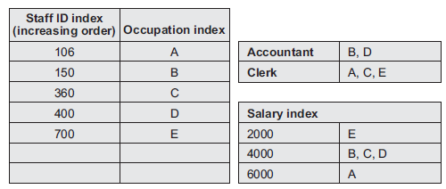
Inverted Files
The concept of the inverted files and multilists is similar.
The difference is that, in multilists records with the same key value are linked together and links are kept in each record.
But in the inverted files, the link information is kept in the index itself.
For example, if staff ID is a primary key, then the inverted list provides staff ID and further staff’s name and other details can be accessed through index.
Two step process:
The indices are searched to obtain a list of required records
Records are retrieved using these lists.

Slide 44

Inverted Files - Disadvantages
As links are kept in the indices, index entries become variable length and therefore index maintenance becomes more complex.
Inverted item values have to be included in both the inverted list and the master file.

Slide 45
Cellular Partitions
To decrease file search time, the storage media may be divided into cells.
A cell may be an entire disk or a cylinder.
Lists are localized to lie within a cell.
If a cylinder is used as a cell, then all records on the same cylinder may be accessed without moving the read/write heads.
Divide multilists organized on several different cylinders into several small lists which are stored on the same cylinder.

Slide 46
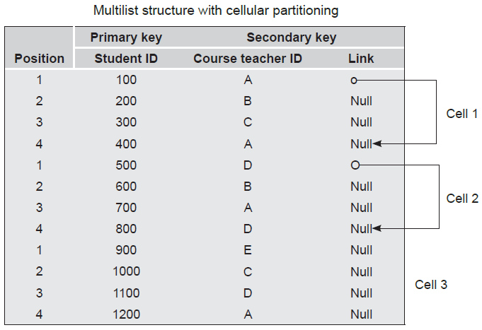
Multilist structure with cellular partitioning
Cells
Links within a cell
Notes:
An entry is created in the secondary index whenever the item value occurs one or more
times in a cellular partition.

Slide 47
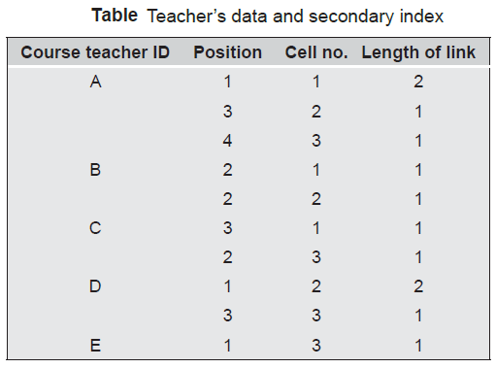
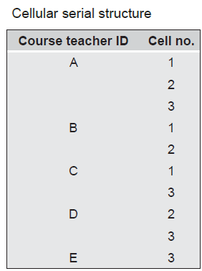
Relative secondary index records for the data
The course teacher ID ‘A’ has entries in each cell, at two positions in cell 1, at one position in cell 2, and at one position in cell 3.

Slide 48
External Sorting
A class of sorting algorithms that can handle massive amounts of data.
Used when the data is bigger than the computer’s internal storage (main memory)
Use secondary storage devices (such as tape drives/hard drives/disk arrays, etc) to store the data.
External sorting typically uses a hybrid sort-merge strategy.
2 Phases:
In the sorting phase, small data chunks(as per Main memory) are read, sorted, and written out to a temporary file.
In the merge phase, the sorted sub-files are combined into a single larger file.
Any sort algorithm that uses external memory, such as tape or disk, during the sorting is called as an external sort algorithm.
Types:
2-way Merge sorting
Multi-way Merge sorting

Slide 49
Two-way Sorting
Assumptions:
Computer’s internal storage can hold three records at a time.
We denote the internal storage capacity by M.
M=3 say 3 memory pages
We use four tape drives.
One pair of tape drives is denoted by T_{a1} and T_{a2}
Other pair is denoted by T_{b1} and T_{b2}
Initially, all the records that have to be sorted are stored on tape drive T_{a1}.
T_{a2} , T_{b1} and T_{b2} are kept empty.

Slide 50

Two-way Sorting Algorithm: Sort Phase
Sort Phase:
Read M records from one tape drive.
Sort the M records in the computer’s internal storage.
If M is small (< 10) use insertion sort.
For larger values of M use quick sort.
Write the sorted M records into the other pair of tape drives (i.e., the pair which does not contain the input records).
While writing the records, alternate between the two tape drives of that pair.
Repeat steps 1-3 until the end of input
Read from T_{a1}
Sort and store
alternatively on
T_{b1} & T_{b2}

Slide 51
Two-Way Sort Phase-Example
Initially, T_{a2} , T_{b1} and T_{b2}
Ta1 | 81 | 94 | 11 | 96 | 12 | 35 | 17 | 99 | 28 | 58 | 41 | 75 | 15
Ta2
Tb1
15
11
81
94
17
28
99
Tb2
12
35
96
41
58
75
Read in 81 94 11 into computer’s internal storage and sort them.
The output is 11 81 94 which gets written onto T_{b1}
Read in 96 12 35 into computer’s internal storage and sort them.
The output is 12 35 96 which gets written onto T_{b2}
Repeat the steps for all the numbers and alternatively storing on Tb1 and Tb2.
Elements of T_{a1} can be removed in the process or can be overwritten later

Slide 52
Two-way Sorting Algorithm: Merge Phase
Merge Phase
Perform merge sort :
Read the data from the input pair of tape drives and
Write the data to the output pair of tape drives
While writing the data alternate between the two tape drives of the output pair
Repeat steps 1 and 2 until nothing is written into one of the output pair of tape drives

Slide 53
Merge Phase Example
At the end of the sort phase the contents of the tape drives are
Ta1
15
11
12
35
81
94
96
17
28
41
58
75
99
Ta2
Tb1
15
11
81
94
17
28
99
Tb2
12
35
96
41
58
75
Pass 1 Merge Phase:
The input drives pair is b-pair and the output pair is the a-pair
Take 3 elements from Tb1,Tb2;sort and save the sorted list on Ta1, Ta2 alternatively.
After pass 1 of the merge phase we get above output

Slide 54
Merge Phase Example (contd.)
Pass 2 Merge Phase:
The input pair of drives for this pass is the a-pair and the output pair is the b-pair
The b-pair now contains the latest merged data and the data in a-pair can be updated/overwritten
Ta1
15
11
12
35
81
94
96
17
28
41
58
75
99
Ta2
Tb1
11
12
17
28
35
41
58
75
81
94
96
99
Tb2
15

Slide 55
Merge Phase Example (contd.)
Pass 3 Merge Phase:
The input pair of drives for this pass is the b-pair and the output pair is the a-pair
After pass 3 of the merge phase we get:
11
12
17
28
35
41
58
75
81
94
96
99
Ta1
15
Ta2
Tb1
11
12
17
28
35
41
58
75
81
94
96
99
Tb2
15
The a-pair now contains the latest merged data and is T_{a2} empty; Process terminates; as the list is sorted
No. of passes in Two-way Sorting = ceil(log ((N/M)))
N = # input records
M = # records that can fit inside internal storage of computer

Slide 56
Two-Way Sort Phase- Another Example
N=14; M = 3; Initially, T_{a2} , T_{b1} and T_{b2}
Ta1 | 7 | 3 | 29 | 56 | 24 | 18 | 4 | 9 | 10 | 6 | 45 | 36 | 11 | 43
Ta2
Tb1
11
43
3
7
29
4
9
10
Tb2
18
24
56
6
36
45
SORTING of runs: Read in 7, 3, 29 into computer’s internal storage and sort them.
The output is 3, 7, 29 which gets written onto T_{b1}
Read next 3 records 56 24 18 into computer’s internal storage and sort them.
The output is 18 24 56 which gets written onto T_{b2}
Repeat the steps for all the numbers and alternatively storing on Tb1 and Tb2.

Slide 57
Pass 1 Merge Phase:
At the end of the sort phase the contents of the tape drives are
Ta1
11
43
3
7
18
24
29
56
4
6
9
10
36
45
Ta2
Tb1
11
43
3
7
29
4
9
10
Tb2
18
24
56
6
36
45
Pass 2 Merge Phase:
Ta1
11
43
3
7
18
24
29
56
Ta2
4
6
9
10
36
45
Tb1
18
24
45
56
3
4
6
7
9
10
29
36
43
Tb2
11

Slide 58
Pass 3 Merge Phase:
Ta1
Ta2
Tb1
18
24
45
56
3
4
6
7
9
10
29
36
43
Tb2
11
Sorted List
Ta1
18
24
56
11
43
3
4
6
7
9
10
29
36
45
Number of passes: log(N/M)
In each pass the size of the runs is doubled, thus we need [log(N/M)]+1 to get to a run equal in size to the original file. This run would be the entire file sorted.
The example needs three passes (B1, B2 and B3)as [Log(14/3)] + 1 = 3.

Slide 59
Multi-way Merge Sorting
Sort phase remains the same as in two-way sorting
In two-way sorting we did a 2-way merge
In multi-way sorting we follow a k-way merge
For this we need two groups of tape drives
Each group contains k tape drives giving 2*k tape drives in all

Slide 60
External Sorting: Example of multiway external sorting
Assumption – We have three tapes (k = 3) and the memory can hold three records.
Ta₁: 17, 3, 29, 56, 24, 18, 4, 9, 10, 6, 45, 36, 11, 43
Main memory sort
The first three records are read into memory, sorted and written on Tb1, the second three records are read into memory, sorted and stored on Tb2, finally the third three records are read into memory, sorted and stored on Tb3.
Now we have one run on each of the three tapes:
Tb1: 3, 17, 29
Tb2: 18, 24, 56
Tb3: 4, 9, 10

Slide 61
Ta₁: 17, 3, 29, 56, 24, 18, 4, 9, 10, 6, 45, 36, 11, 43
The next portion of three records is sorted into main memory and stored as the second run on Tb1:
Tb₁: 3, 17, 29, 6, 36, 45
The next portion, which is also the last one, is sorted and stored onto Tb2:
Tb₂: 18, 24, 56, 11, 43
Nothing is stored on Tb₃.
Thus, after the main memory sort, our tapes look like this:
Tb₁: 3, 17, 29, | 6, 36, 45,
Tb₂: 18, 24, 56, | 11, 43
Tb₃: 4, 9, 10

Slide 62
Merging:
Tb₁: 3 , 17, 29, | 6, 36, 45
Tb₂: 18, 24, 56, | 11, 43
Tb₃: 4, 9, 10
Merging runs of length M to obtain runs of length k*M
In our example we merge runs of length 3 and the resulting runs would be of length 9.
Build a heap tree in main memory out of the first records in each tape. These records are: 3, 18, and 4.
We take the smallest of them - 3, using the deleteMin operation, and store it on tape Ta₁
The record '3' belonged to Tb1, so we read the next record from Tb1 - 17, and insert it into the heap. Now the heap contains 18, 4, and 17.
The next deleteMin operation will output 4, and it will be stored on Ta1.
The record '4' belonged to Tb₃, so we read the next record '9' from Tb₃ for heap sort; Now the heap contains 18, 17 and 9. ---Repeat process
Ta1
24
29
56
3
4
9
10
17
18

Slide 63
Tb₁: 3 , 17, 29, | 6, 36, 45
Tb₂: 18, 24, 56, | 11, 43
Tb₃: 4, 9, 10
Build a heap of the second three runs & store the sorted result on Ta2
Ta1
24
29
56
3
4
9
10
17
18
Ta1
6
11
36
43
45
Next merge Phase: with 2 tapes: Ta1 and Ta2
Build a heap of the first elements of the two tapes i.e. 3 and 6, and output the smallest element '3' to tape Tb1.
We read the next record from the tape where the record '3' belonged i.e. Ta1, and insert it into the heap.
Now the heap contains 6 and 4, and using the deleteMin operation the smallest record - 4 is output to tape Tb1.
Proceeding in this way, the entire file will be sorted on tape Tb1.
Tb1: 3, 4, 6, 9, 10, 11, 17, 18, 24, 29, 36, 43, 45, 56
The number of passes for the multiway merging is log_{k}(N/M). In the example this is [log₃(14/3)] + 1 = 2.

Slide 64

Summary – Unit 5
File terminologies
File Organization
Programming approach in Python
Linked Organization
External Sorting

